Slide 1


Slide 2


Final project criteria
Should be submited as Python file → No report needed
Group of 3 – 4 students
Deadline: 26.02.2020
Will be evaluated by following criterias:
Creative idea, which is interesting for everybody. Useful for your studies, hobby or everyday life.
Code is easy to read and maintain
If used Github or Stackoverflow code must be changed for your needs. NO COPYPASTING!
(meme-arsenal.com 2019)

Slide 3
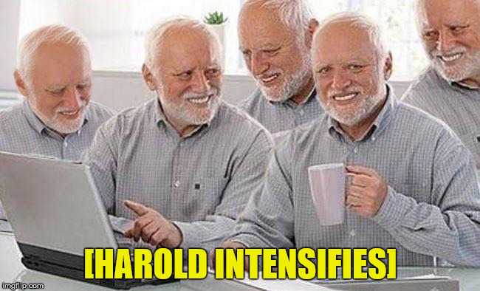
Final project criteria
Try to:
Put your project program in one class
Use modules instead of reinventing the wheel – you can find list of them in here:
https://docs.python.org/3/py-modindex.html
Divide your project class to meaningful functions
Use while and for loops when it is necessary
(imgflip.com 2019)

Slide 4

Final project criteria
Example basic projects:
To-do list app
Password generator
Shopping list with groupping of items and calculation of your shopping budget
Quiz app or simple rpg
Intermediate:
Binary search algorithm
Finance tracker
File renaming tool
MP3 player
Advanced:
Train neural network on fashion MNIST dataset
Using Arduino, create weather station
Computer vision for coin (any circular shape) identification
(tumblr.com 2019)

